Slide 1
Cyber Coding Project
By: Tri Nguyen and Akash Dansinghani

Slide 2
Cipher Algorithm
Caesar Cipher algorithm needs two things:
Plaintext to convert into Ciphertext (vice versa)
Key to encrypt it (also decrypt)
Once the plaintext and key are given, each letter in the alphabet (26 indices) are shifted by that key (Ex. if the key is 3 then a = d, b = e etc.) and then the ciphertext is created
To decrypt the ciphertext to get the original message (plaintext) we shift the letters back using the key and we get the characters back in the correct place and we can generate the plaintext.

Slide 3
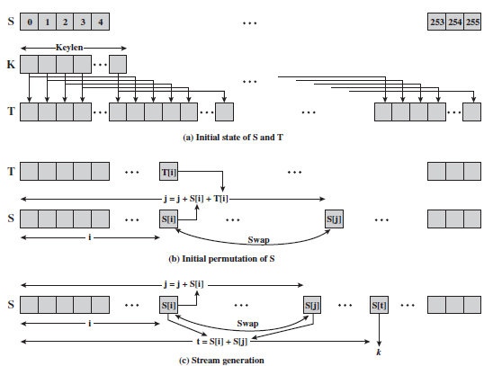
RC4 Algorithm
What is needed for RC4 algorithm:
Plaintext and Secret Key (Public and Private Keys)
How RC4 works:
We receive the plain text and secret key
We take the length of the key and use that to generate the state or array S. Then we use the KSA (Key Scheduling) algorithm in conjunction with the secret key provided by the user and we swap each bit in the array until the array is arranged. (Using S[i] and S[j])
Then we use the PRGA algorithm where we use array S[mod] and generate the keystream
Finally we use the RC4 algorithm to scramble the array and generate the ciphertext
We can easily decrypt it since when generating the keystream since it uses XOR bits

Slide 4
RSA Algorithm
RSA is consisted of 4 steps, key generation, key distribution, encryption, and decryption.
Key generation
Requires 2 prime numbers, and public key(e)
Compute for modulus by multiplying the 2 prime numbers
Compute for totient
Compute for d by doing Multiplicative Inverse which will be using Extended Euclidean of the e(public key) and totient
It should find the value of d where d*public_key% totient = 1
Key distribution
Share the public key to other party
Encryption
Get the index value of the character using “ord” python built in function
We will use the index value exponent public_key mod n (from p*q, the two prime numbers)
Decryption
We will take an encryption value, which is now in int value, we will use that int value exponent to private_key(d) mod n (from p*q, the two prime numbers)

Slide 5
Comparison
In term of speed , the follow algorithms is in an ascending order: Caesar Cipher | RC4 | RSA
Caesar cipher is the fastest because its job is simply shift the letter to the corresponding key
RC4 is the second fastest algorithm because it is a stream cipher which allows the encryption and decryption process to be faster (Specifically because of the KSA algorithm and the keystream)
RSA is the slowest of these algorithms due to the calculations within the algorithms
In term of Security
Caesar cipher is the least secure due to its decrypted function, we can use brute force attack to check the 25 keys.
RC4 weakness come from the insufficient key schedule, the first bytes of output reveal information about the key
RSA is the most secure of the three algorithms because it cannot be decrypted without knowing the 2 primes numbers. Also know the public key does not allow or give any clues away for the decryption.

